Slide 1
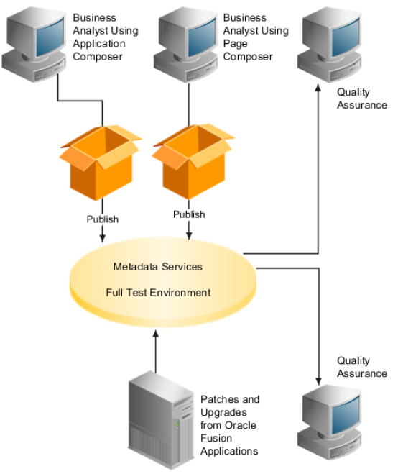

Manage Sandboxes
Sandbox
Use of Sandboxes
Types of Sandboxes
Concurrent Use of Sandboxes
Single Sandbox
Multiple Sandboxes
Conflicts Resolution in Concurrent Use
Create & Activate Sandbox
Publish Sandbox

Slide 2
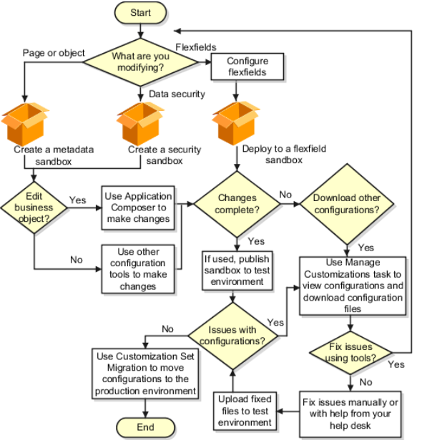
Use of Sandboxes
Type of Changes | Type of Sandbox | Method to publish changes | Downloadable?
MetaData | Sandbox | Publish Sandbox | Yes
Data Security | Security Sandbox | Publish Sandbox | Yes
Flexfield | Flexfield Sandbox | Deploy Flexfield | No

Slide 3
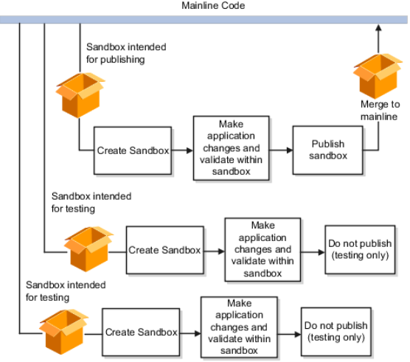
Types of Sandboxes
Intended to Publish
Testing Only

